Slide 1

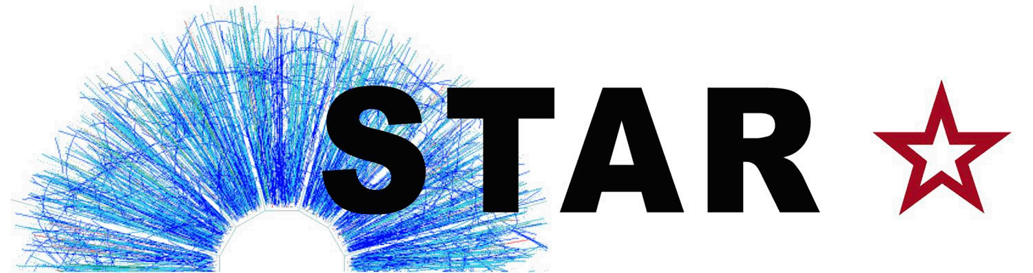




An Investigation of Charm Quark Jet Spectrum and
Shape Modifications in Au+Au Collisions at $\sqrt{s_{NN}}$ = 200 GeV
Diptanil Roy
Rutgers University
For the STAR Collaboration
roydiptanil@gmail.com
Supported in part by
Notes:
Hi everyone. My name is Diptanil Roy, on behalf of STAR, I am going to present our preliminary study of heavy flavor tagged jets in heavy ion collisions at RHIC energies. I want to thank the organisers for providing me with this opportunity to share some exciting new results from STAR. Now, without much further ado, let’s get started.

Slide 2
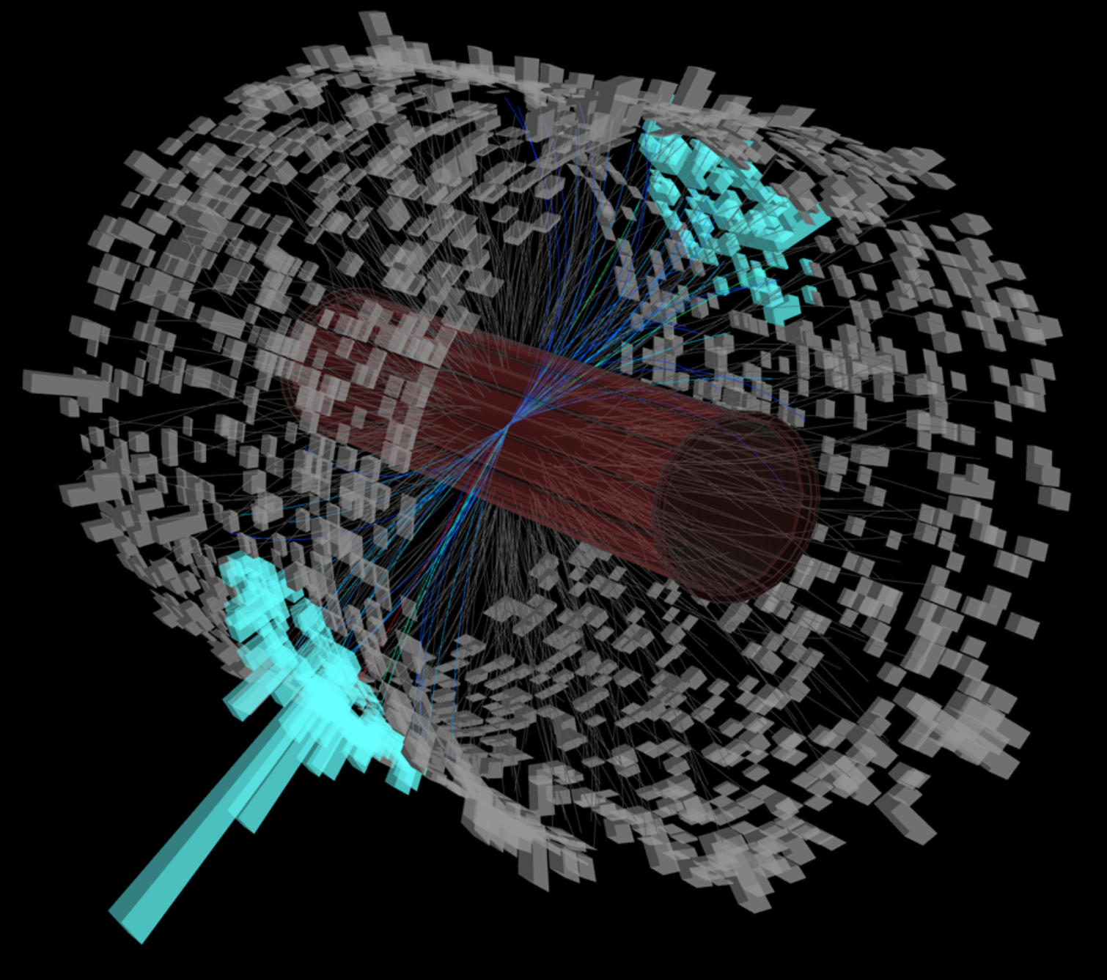

Jets in Heavy Ion Collisions
Strong interaction between high p_{T} partons and medium → Way to probe QGP’s transport properties
Jets reconstructed by a sequential clustering algorithm, commonly anti-k_{T}
Loss of parton energy in the QGP medium
Parton shower broadened due to medium-induced radiation and scattering
FASTJET, Phys. Lett. B 641 (2006) 57-61
Notes:
In heavy ion collisions, Lorentz contracted nuclei collide at relativistic speeds to form Quark-Gluon Plasma. Now, to study the properties of Quark Gluon Plasma, we rely on internal probes which are sensitive to the QGP medium i.e. has a significant interaction with the medium. These include processes with large momentum transfer.
One such probe that we use is Jets. Jets are these collimated cluster of particles fragmenting from a high momentum quark or gluon. Since quarks and gluons can’t remain unbounded, they fragment into particles via radiation. These particles have momenta in similar direction. Experimentally, we use a jet reconstruction algorithm, which uses some form of distance measure to cluster such particles that move in the same direction. This is an event display of two jets in the STAR detector., shown by their energy deposits in the calorimeter.
Jets not only lose energy through interaction with the QGP medium, but is also broadened in its presence. On the right, I show an RCP measurement for charged jets as a function of transverse momenta of charged tracks and jets. The dark blue data points are the ratio of charged jet yields in central and peripheral collisions at RHIC. The red closed circles are the same measurement at LHC energies. We see a significant suppression in the yield in the most central case, and this shows that jets are quenched in the presence of the QGP medium.

Slide 3
Jets in Heavy Ion Collisions
Strong interaction between high p_{T} partons and medium → Way to probe QGP’s transport properties
ALICE, JHEP03 (2014) 013
STAR, Phys.Rev.C 102 (2020) 5, 054913
Jets reconstructed by a sequential clustering algorithm, commonly anti-k_{T}
Loss of parton energy in the QGP medium
Parton shower broadened due to medium-induced radiation and scattering
FASTJET, Phys. Lett. B 641 (2006) 57-61
Inclusive jets are heavily quenched in the presence of QGP
Notes:
In heavy ion collisions, Lorentz contracted nuclei collide at relativistic speeds to form Quark-Gluon Plasma. Now, to study the properties of Quark Gluon Plasma, we rely on internal probes which are sensitive to the QGP medium i.e. has a significant interaction with the medium. These include processes with large momentum transfer.
One such probe that we use is Jets. Jets are these collimated cluster of particles fragmenting from a high momentum quark or gluon. Since quarks and gluons can’t remain unbounded, they fragment into particles via radiation. These particles have momenta in similar direction. Experimentally, we use a jet reconstruction algorithm, which uses some form of distance measure to cluster such particles that move in the same direction. This is an event display of two jets in the STAR detector., shown by their energy deposits in the calorimeter.
Jets not only lose energy through interaction with the QGP medium, but is also broadened in its presence. On the right, I show an RCP measurement for charged jets as a function of transverse momenta of charged tracks and jets. The dark blue data points are the ratio of charged jet yields in central and peripheral collisions at RHIC. The red closed circles are the same measurement at LHC energies. We see a significant suppression in the yield in the most central case, and this shows that jets are quenched in the presence of the QGP medium.

Slide 4
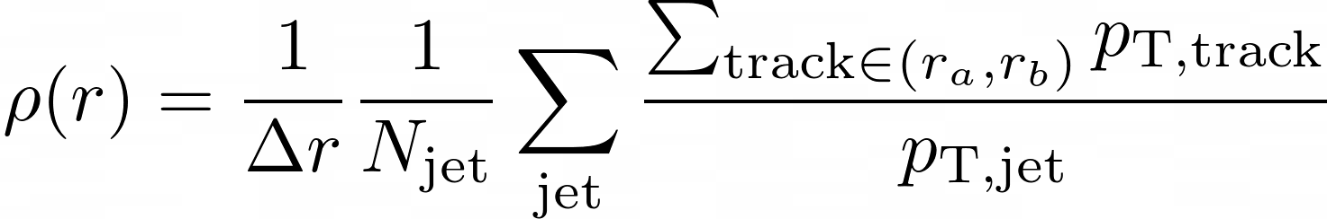
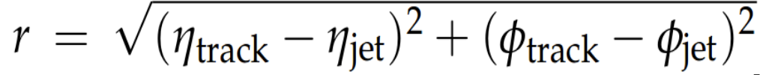
Motivation
Notes:
I also mentioned that jets are broadened in the presence of QGP. Such broadening can be seen in measurements of the differential jet shape in heavy ion collisions and proton proton collisions at LHC and RHIC energies. Differential jet shape is. the fraction of transverse momenta in the jet as a function of distance from jet axis.
This is a measurement from the CMS experiment, which shows the ratio of the differential jet shape in the most central Pb-Pb event vs pp. The jet momenta and hence energy in jets in central collisions is found to be depleted at intermediate radii and redistributed at larger radii from the jet axis when compared to pp collisions, meaning the jets are more diffused in central HI collisions. These behavior is no longer observed in peripheral collisions where the volume of QGP created is small.
A similar measurement of differential jet shape from STAR for inclusive jets in the most central AuAu events at 200 GeV is shown here. A comparison with the baseline from pp Is underway. Stay tuned for those results.
The major factors which can lead to such broadening are collisional processes like scattering, and radiative processes like medium-induced bremstrak and in medium scattering, and they are dependent on the mass of the underlying parton. This provides us with a good motivation to look at jets fragmenting from heavier quarks.

Slide 5
Motivation
CMS, Phys. Lett. B 730 (2014) 243
Jet energy is redistributed to large distances from the jet axis in the presence of QGP
Notes:
I also mentioned that jets are broadened in the presence of QGP. Such broadening can be seen in measurements of the differential jet shape in heavy ion collisions and proton proton collisions at LHC and RHIC energies. Differential jet shape is. the fraction of transverse momenta in the jet as a function of distance from jet axis.
This is a measurement from the CMS experiment, which shows the ratio of the differential jet shape in the most central Pb-Pb event vs pp. The jet momenta and hence energy in jets in central collisions is found to be depleted at intermediate radii and redistributed at larger radii from the jet axis when compared to pp collisions, meaning the jets are more diffused in central HI collisions. These behavior is no longer observed in peripheral collisions where the volume of QGP created is small.
A similar measurement of differential jet shape from STAR for inclusive jets in the most central AuAu events at 200 GeV is shown here. A comparison with the baseline from pp Is underway. Stay tuned for those results.
The major factors which can lead to such broadening are collisional processes like scattering, and radiative processes like medium-induced bremstrak and in medium scattering, and they are dependent on the mass of the underlying parton. This provides us with a good motivation to look at jets fragmenting from heavier quarks.

Slide 6
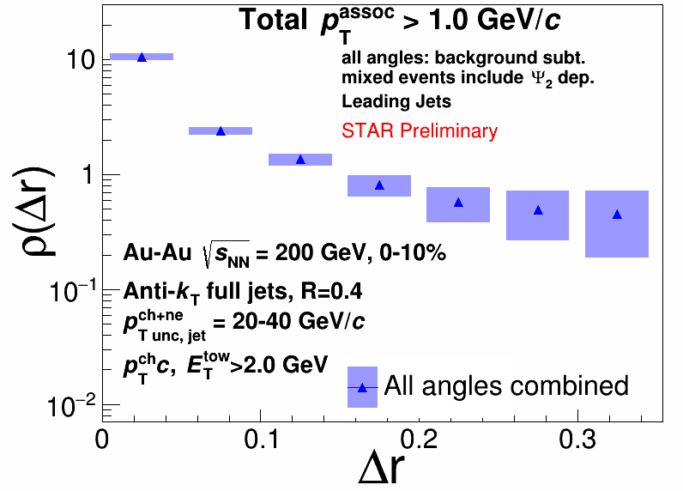
Motivation
CMS, Phys. Lett. B 730 (2014) 243
Jet energy is redistributed to large distances from the jet axis in the presence of QGP
Notes:
I also mentioned that jets are broadened in the presence of QGP. Such broadening can be seen in measurements of the differential jet shape in heavy ion collisions and proton proton collisions at LHC and RHIC energies. Differential jet shape is. the fraction of transverse momenta in the jet as a function of distance from jet axis.
This is a measurement from the CMS experiment, which shows the ratio of the differential jet shape in the most central Pb-Pb event vs pp. The jet momenta and hence energy in jets in central collisions is found to be depleted at intermediate radii and redistributed at larger radii from the jet axis when compared to pp collisions, meaning the jets are more diffused in central HI collisions. These behavior is no longer observed in peripheral collisions where the volume of QGP created is small.
A similar measurement of differential jet shape from STAR for inclusive jets in the most central AuAu events at 200 GeV is shown here. A comparison with the baseline from pp Is underway. Stay tuned for those results.
The major factors which can lead to such broadening are collisional processes like scattering, and radiative processes like medium-induced bremstrak, and they are dependent on the mass of the underlying parton. This provides us with a good motivation to look at jets fragmenting from heavier quarks.

Slide 7
Motivation
Possible mechanisms:
Multiple scattering
Medium-induced Bremsstrahlung
Medium response
Dependent on the mass of the underlying parton
CMS, Phys. Lett. B 730 (2014) 243
Motivation to study heavy-flavor jets
Jet energy is redistributed to large distances from the jet axis in the presence of QGP
Notes:
I also mentioned that jets are broadened in the presence of QGP. Such broadening can be seen in measurements of the differential jet shape in heavy ion collisions and proton proton collisions at LHC and RHIC energies. Differential jet shape is. the fraction of transverse momenta in the jet as a function of distance from jet axis.
This is a measurement from the CMS experiment, which shows the ratio of the differential jet shape in the most central Pb-Pb event vs pp. The jet momenta and hence energy in jets in central collisions is found to be depleted at intermediate radii and redistributed at larger radii from the jet axis when compared to pp collisions, meaning the jets are more diffused in central HI collisions. These behavior is no longer observed in peripheral collisions where the volume of QGP created is small.
A similar measurement of differential jet shape from STAR for inclusive jets in the most central AuAu events at 200 GeV is shown here. A comparison with the baseline from pp Is underway. Stay tuned for those results.
The major factors which can lead to such broadening are collisional processes like scattering, and radiative processes like medium-induced bremstrak and in medium scattering, and they are dependent on the mass of the underlying parton. This provides us with a good motivation to look at jets fragmenting from heavier quarks. Let’s look at some existing results on the same.

Slide 8
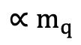
Heavy Flavor Tagged Jets
Jet
ALICE, arXiv:2106.05713 (2021)
$$∝m_{q}$$
Notes:
So what is a heavy flavor jet then? For the results I will discuss from this point, a heavy flavor jet is one which has a D0 meson as a candidate. The D0 meson is reconstructed from the Kaon Pion decay channel, and the daughter tracks are in the jet by the D0 candidate.
This is a cartoon showing the gluon radiation pattern of a charm quark. The radiation from charm, a heavy quark, is suppressed in a cone around the direction of propagation of the quark. This is the known as the dead cone effect, and It is dependent on the mass of the radiating quark.
Here we show a measurement of the effect in proton-proton collisions at 13 TeV in ALICE. The red data points are from ALICE, and blue and green solid lines are from Pythia and SHERPA, MC event generators respectively. The ratio of the splitting angle distributions for charm jets vs inclusive jets is plotted here. The dotted markers shows the same ratio for the case of no dead cone effect in PYTHIA and SHERPA, and this enhancement here signifies that light quark radiation is more collinear than gluon radiation. The data shows that the contribution from charm quark jets is suppressed at small splitting angles, with the suppression being of the order of this difference. So we know that the heavy flavor emission spectra is modified in vacuum.
What happens to these charm jets in the medium then? This result from CMS shows the radial distribution of the D0 mesons in jets. The red points are from PbPb collisions, and the blue points are from pp collisions at 5 TeV. The ratio of the PbPb and pp distributions are shown in the middle panel for a low D0 pT bin compared to the jet. Low transverse momenta D0s are slightly more diffused in heavy ion collisions than in pp collisions. The bottom panel shows the ratio between the results from PYTHIA and from pp collision data at LHC, and the key takeaway is that PYTHIA can explain the results from pp quite` well at LHC energies.
This is at LHC energies, so we want to perform a similar study in the lower RHIC energy regime where this low pT region is better accessible for D0 mesons. We will additionally show the first measurement of charm jet spectrum at RHIC energies. Before we go to the results, I will briefly discuss the STAR detector system we used.

Slide 9
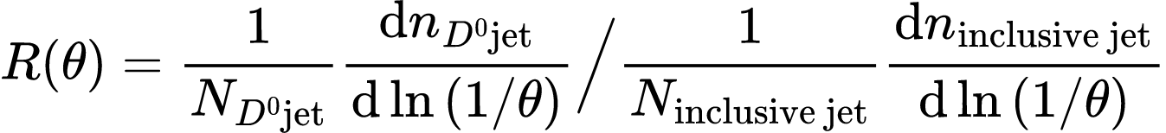
Heavy Flavor Tagged Jets
Jet
ALICE, arXiv:2106.05713 (2021)
Dead Cone
$$∝m_{q}$$
Heavy-flavor emission spectra at small angles suppressed due to dead-cone effect
Notes:
So what is a heavy flavor jet then? For the results I will discuss from this point, a heavy flavor jet is one which has a D0 meson as a candidate. The D0 meson is reconstructed from the Kaon Pion decay channel, and the daughter tracks are in the jet by the D0 candidate.
This is a cartoon showing the radiation pattern of a charm quark. The radiation from charm, a heavy quark, is suppressed in a cone around the direction of propagation of the quark. This is the known as the dead cone effect and is dependent on the mass of the radiating quark.
Here we show a measurement of the effect in proton-proton collisions at 13 TeV in ALICE. The red data points are from ALICE, and blue and green solid lines are from Pythia and SHERPA, MC event generators respectively. The ratio of the splitting angle distributions for charm jets vs inclusive jets is plotted here. The dotted markers shows the same ratio for the case of no dead cone effect in PYTHIA and SHERPA, and this enhancement here signifies that light quark radiation is more collinear than gluon radiation. The data shows that the contribution from charm quark jets is suppressed at small splitting angles, with the suppression being of the order of this difference. So we know that the heavy flavor emission spectra is suppressed due to the dead cone effect.
What happens to these charm jets in the medium then? This result from CMS shows the radial distribution of the D0 mesons in jets. The red points are from PbPb collisions, and the blue points are from pp collisions at 5 TeV. The ratio of the PbPb and pp distributions are shown in the middle panel for a low D0 pT bin compared to the jet. Low transverse momenta D0s are slightly more diffused in heavy ion collisions than in pp collisions. The bottom panel shows the ratio between the results from PYTHIA and from pp collision data at LHC, and the key takeaway is that PYTHIA can explain the results from pp quite` well at LHC energies.
This is at LHC energies, so we want to perform a similar study in the lower RHIC energy regime where this low pT region is better accessible for D0 mesons. We will additionally show the first measurement of charm jet spectrum at RHIC energies. Before we go to the results, I will briefly discuss the STAR detector system we used.

Slide 10
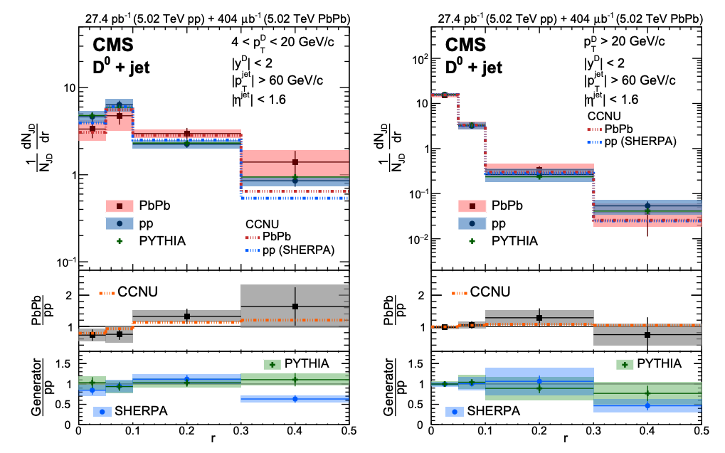
Heavy Flavor Tagged Jets
CMS, Phys. Rev. Lett. 125 (2020) 102001
Jet
r
Low p_{T} D⁰ mesons appear to be diffused in the presence of QGP at LHC
Lower p_{T} D⁰ mesons can be reconstructed at RHIC energies
Contribution from the underlying background is smaller at RHIC
Notes:
So what is a heavy flavor jet then? For the results I will discuss from this point, a heavy flavor jet is one which has a D0 meson as a candidate. The D0 meson is reconstructed from the Kaon Pion decay channel, and the daughter tracks are in the jet by the D0 candidate.
This is a cartoon showing the gluon radiation pattern of a charm quark. The radiation from charm, a heavy quark, is suppressed in a cone around the direction of propagation of the quark. This is the known as the dead cone effect and is dependent on the mass of the radiating quark.
Here we show a measurement of the effect in proton-proton collisions at 13 TeV in ALICE. The red data points are from ALICE, and blue and green solid lines are from Pythia and SHERPA, MC event generators respectively. The ratio of the splitting angle distributions for charm jets vs inclusive jets is plotted here. The dotted markers shows the same ratio for the case of no dead cone effect in PYTHIA and SHERPA, and this enhancement here signifies that light quark radiation is more collinear than gluon radiation. The data shows that the contribution from charm quark jets is suppressed at small splitting angles, with the suppression being of the order of this difference. So we know that the heavy flavor emission spectra is modified in vacuum.
What happens to these charm jets in the medium then? This result from CMS shows the radial profile of the D0 mesons in jets. The red points are from PbPb collisions, and the blue points are from pp collisions at 5 TeV. The ratio of the PbPb and pp distributions are shown in the middle panel for a low D0 pT bin compared to the jet. Low transverse momenta D0s are slightly more diffused in heavy ion collisions than in pp collisions. The bottom panel shows the ratio between the results from PYTHIA and from pp collision data at LHC, and the key takeaway is that PYTHIA can explain the results from pp quite` well at LHC energies.
This is at LHC energies, so we want to perform a similar study in the lower RHIC energy regime where this low pT region is better accessible for D0 mesons. We will additionally show the first measurement of charm jet spectrum at RHIC energies. Before we go to the results, I will briefly discuss the STAR detector system we used.

Slide 11
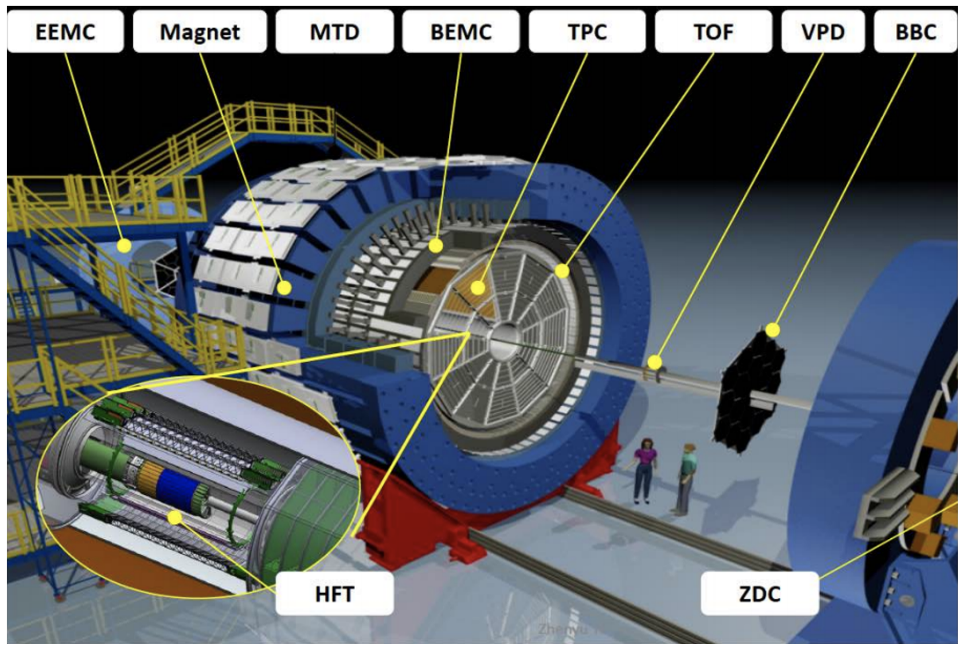
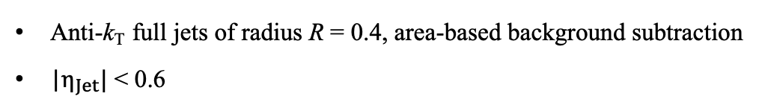
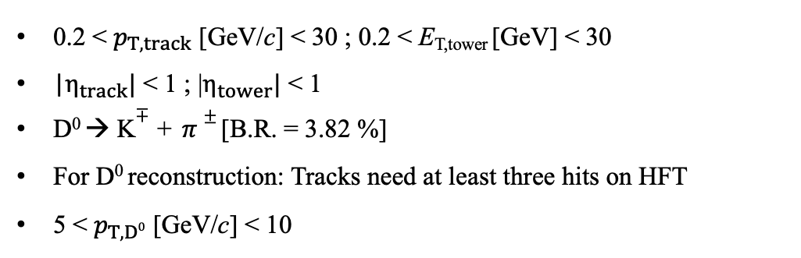
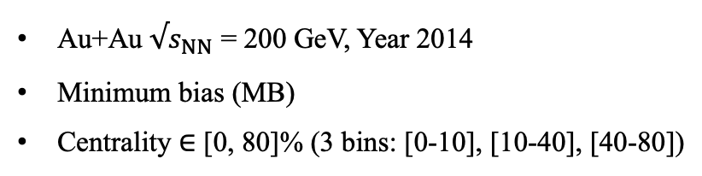
STAR Detector & Selection Criteria
Time Projection Chamber (TPC)
- Measures momentum, track trajectory, and identifies charged particles
Event Selection:
Time-of-Flight Detector (TOF)
- Identifies charged particles
Au+Au $√s_{NN}$ = 200 GeV, Year 2014
Minimum bias (MB)
Centrality $∈$ [0, 80]% (3 bins: [0-10], [10-40], [40-80])
Constituent Selection:
0.2 < $p_{T,track }$[GeV/c] < 30 ; 0.2 < E_{T,tower} [GeV] < 30
|$η_{track}|$ < 1 ; |$η_{tower}|$ < 1
D⁰ → K$∓$ + $π±$ [B.R. = 3.82 %]
For D⁰ reconstruction: Tracks need at least three hits on HFT
5 < $p_{T,D0 }$[GeV/c] < 10
D⁰ Jet Selection:
Barrel Electromagnetic Calorimeter (BEMC)
- Measures neutral component of energy in jets
Anti-k_{T} full jets of radius R = 0.4, area-based background subtraction
|$η_{Jet}|$ < 0.6
Heavy Flavor Tracker (HFT)
- Improves position resolution for tracks
Notes:
The STAR detector has many sub-detector systems. The important ones for our analysis are:
Time Projection Chamber: Measures momenta and track information, identifies charged tracks using ionization energy loss measurement
Time-of-Flight Detector System: Identifies particle using time of flight measurement
Heavy Flavor Tracker: Improves Position Resolution for secondary vertex measurement.
Barrel Electromagnetic Calorimeter: Measures neutral component of energy in jets
We will report our measurements for D0 pT > 5 GeV in AuAu 200 GeV minimum bias collisions. The results will be reported in 3 centrality bins (0-10 for central, 10-40 for midcentral, 40-80 for peripheral). We reconstruct the D0 from the Kpi decay, and require the D0 to have hits in the Heavy Flavor Tracker detector.

Slide 12
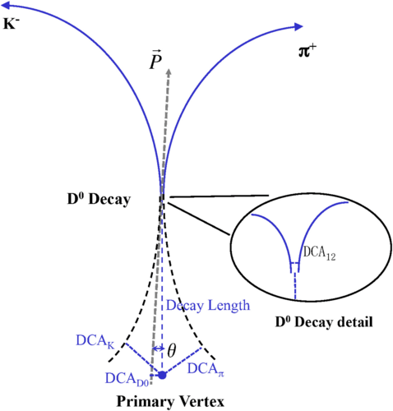

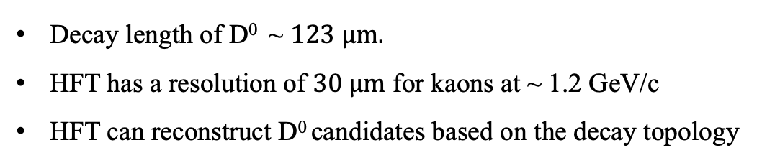
D⁰ Reconstruction
Kaons and Pions identified using TPC and TOF
STAR, Phys. Rev. C 99 (2021) 034908
Decay length of D⁰ ~ $123 μm.$
HFT has a resolution of $30 μm$ for kaons at ~ 1.2 GeV/c
HFT can reconstruct D⁰ candidates based on the decay topology
Topological cuts on the D⁰ candidates improve signal significance
Notes:
For D0 candidates, we identify Kaons and Pions using a hybrid PID method from the Time Projection Chamber and Time of Flight detector. To suppress the background, some topological cuts based on the decay geometry are applied to the D0 candidates. That is possible due to the Heavy Flavor Tracker Detector, which improves the resolution of the tracking from 1 mm at TPC to about 30 microns. That makes it possible for us to constrain Kpi candidates based on their decay kinematics. The effect of the HFT can be seen on the right plot, where the signal significance is greatly improved with the topological cuts. Now, moving on to extracting the yield of D0-tagged jets!

Slide 13
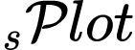
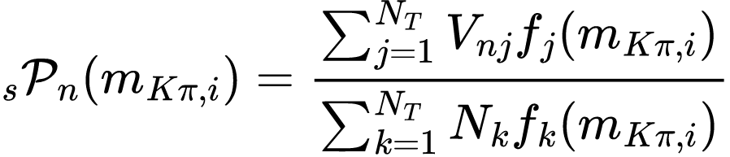
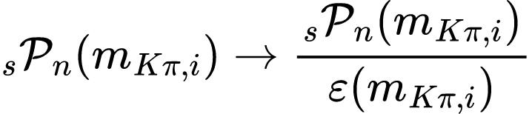
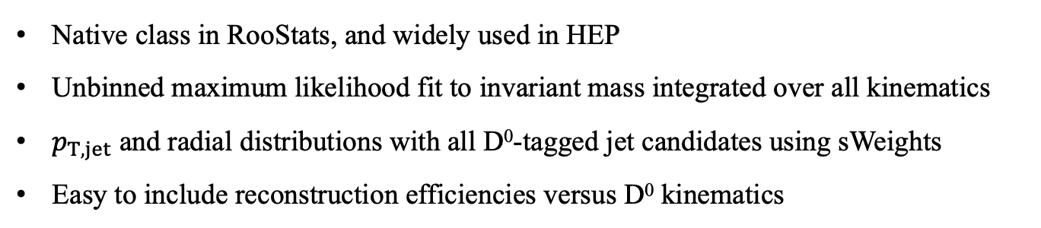
D⁰-Jet Yield Extraction
Nucl. Instrum. Methods Phys. Res., A (2005) 555
Native class in RooStats, and widely used in HEP
Unbinned maximum likelihood fit to invariant mass integrated over all kinematics
$p_{T,jet}$ and radial distributions with all D⁰-tagged jet candidates using sWeights
Easy to include reconstruction efficiencies versus D⁰ kinematics
STAR
Unbinned max. likelihood fit
n = n-th fit component(sig/bkg)
Nk = k-th yield (T=2)
fk(mKπ,i) = per-event PDF value with k^{th} hypothesis
V = cov. matrix
Efficiency Correction
For more information about , visit poster by Matthew Kelsey [T11_2, #367].
Notes:
To extract the yield of D0-tagged jets, we use a method called the sPlot. It is a widely used method in HEP, and is available as a native package in RooStats. It calculates per event weights, where the weights classify how signal like the event is vs how bg like the event is. The definition of sWeights is shown here in this equation, where V denotes the covariance matrix, fi denotes the probability distribution for the signal and background species. These quantitites are determined from an unbinned likelihood fit to the D0 mass over all kinematics.
The resultant distribution represent the statistical distribution of the observables in the data. It is basically a fancy side-band subtraction. The yields from sPlot are consistent with like sign background contribution subtracted yields. Now before we show our results, we need to show the corrections to the jet yield

Slide 14
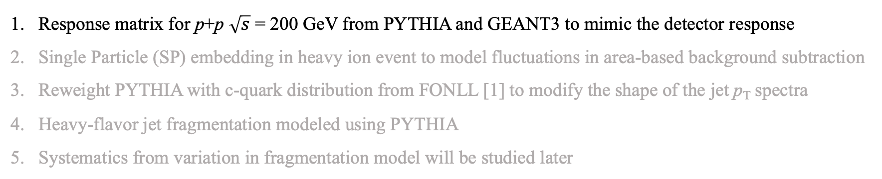
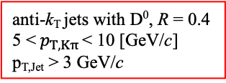
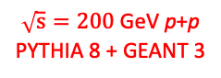
Correction to the Jet Yield
Response matrix for p+p $\sqrt{s}$ = 200 GeV from PYTHIA and GEANT3 to mimic the detector response
Single Particle (SP) embedding in heavy ion event to model fluctuations in area-based background subtraction
Reweight PYTHIA with c-quark distribution from FONLL [1] to modify the shape of the jet p_{T} spectra
Heavy-flavor jet fragmentation modeled using PYTHIA
Systematics from variation in fragmentation model will be studied later
anti-k_{T} jets with D⁰, R = 0.4
5 <${ p}_{T, Kπ }$< 10 [GeV/c]
p_{T,Jet} > 3 GeV/c
$\sqrt{s}=200$ GeV p+p
PYTHIA 8 + GEANT 3
[1]. FONLL, JHEP03 (2001) 006
Notes:
We use PYTHIA plus GEANT to simulate D0 jets in proton proton events, and get the detector response. We do an area based background subtraction to our jets in data. While on average, it yields good results, there are significant fluctuations to this correction. We then use single particle embedding in minimum bias heavy ion events to model this fluctuation.
We also reweight pythia so that the FONLL charm quark spectra matches the particle level jet pT spectra from pythia. The heavy flavor jet fragmentation is modeled from pythia. We will study the variation of our measurements with different fragmentation models later, so systematics from such variation are not included currently.
This is the final response matrix we use to unfold our measurements. For radial distribution, we set up a 2D unfolding method following similar steps. With this, I now present to you the first measurement of charm quark jet spectrum at RHIC energies.

Slide 15
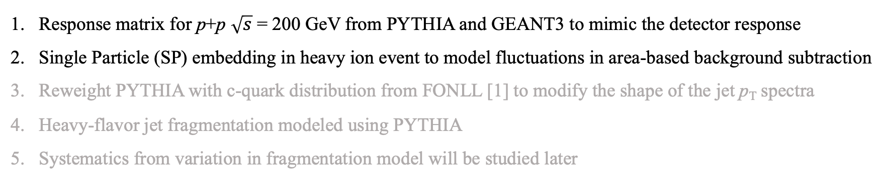
Correction to the Jet Yield
Response matrix for p+p $\sqrt{s}$ = 200 GeV from PYTHIA and GEANT3 to mimic the detector response
Single Particle (SP) embedding in heavy ion event to model fluctuations in area-based background subtraction
Reweight PYTHIA with c-quark distribution from FONLL [1] to modify the shape of the jet p_{T} spectra
Heavy-flavor jet fragmentation modeled using PYTHIA
Systematics from variation in fragmentation model will be studied later
anti-k_{T} jets with D⁰, R = 0.4
5 <${ p}_{T, Kπ }$< 10 [GeV/c]
p_{T,Jet} > 3 GeV/c
$\sqrt{s}=200$ GeV p+p
PYTHIA 8 + GEANT 3
Au+Au Heavy Ion Background
X
[1]. FONLL, JHEP03 (2001) 006
Notes:
We use PYTHIA plus GEANT to simulate D0 jets in proton proton events, and get the detector response. We do an area based background subtraction to our jets in data. While on average, it yields good results, there are significant fluctuations to this correction. We then use single particle embedding in minimum bias heavy ion events to model this fluctuation.
We also reweight pythia so that the FONLL charm quark spectra matches the particle level jet pT spectra from pythia. The heavy flavor jet fragmentation is modeled from pythia. We will study the variation of our measurements with different fragmentation models later, so systematics from such variation are not included currently.
This is the final response matrix we use to unfold our measurements. For radial distribution, we set up a 2D unfolding method following similar steps. With this, I now present to you the first measurement of charm quark jet spectrum at RHIC energies.

Slide 16
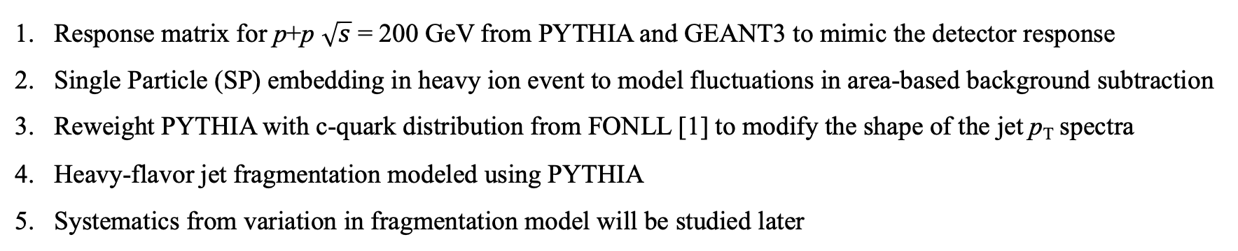
Correction to the Jet Yield
Response matrix for p+p $\sqrt{s}$ = 200 GeV from PYTHIA and GEANT3 to mimic the detector response
Single Particle (SP) embedding in heavy ion event to model fluctuations in area-based background subtraction
Reweight PYTHIA with c-quark distribution from FONLL [1] to modify the shape of the jet p_{T} spectra
Heavy-flavor jet fragmentation modeled using PYTHIA
Systematics from variation in fragmentation model will be studied later
anti-k_{T} jets with D⁰, R = 0.4
5 <${ p}_{T, Kπ }$< 10 [GeV/c]
p_{T,Jet} > 3 GeV/c
$\sqrt{s}=200$ GeV p+p
PYTHIA 8 + GEANT 3
Au+Au Heavy Ion Background
PYTHIA 8 + GEANT 3 + Au+Au Heavy Ion Background
0-10%
X
FONLL
Reweight
[1]. FONLL, JHEP03 (2001) 006
Complete response matrix to unfold p_{T,Jet}
Notes:
We use PYTHIA plus GEANT to simulate D0 jets in proton proton events, and get the detector response. We do an area based background subtraction to our jets in data. While on average, it yields good results, there are significant fluctuations to this correction. We then use single particle embedding in minimum bias heavy ion events to model this fluctuation.
We also reweight pythia so that the FONLL charm quark spectra matches the input particle level jet pT spectra. The heavy flavor jet fragmentation is modeled from pythia. We will study the variation of our measurements with different fragmentation models later, so systematics from such variation are not included currently.
This is the final response matrix we use to unfold our measurements. For radial distribution, we set up a 2D unfolding method following similar steps. With this, I now present to you the first measurement of charm quark jet spectrum at RHIC energies.

Slide 17
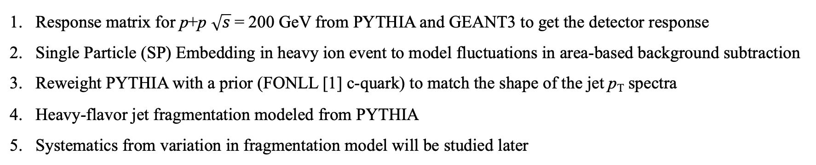
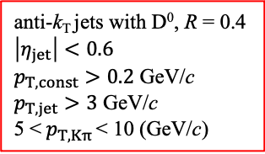
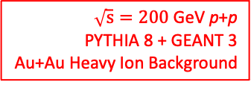
Correction to the Jet Radial Profile
Response matrix for p+p $\sqrt{s}$= 200 GeV from PYTHIA and GEANT3 to get the detector response
Single Particle (SP) Embedding in heavy ion event to model fluctuations in area-based background subtraction
Reweight PYTHIA with a prior (FONLL [1] c-quark) to match the shape of the jet p_{T} spectra
Heavy-flavor jet fragmentation modeled from PYTHIA
Systematics from variation in fragmentation model will be studied later
0-10%
anti-k_{T} jets with D⁰, R = 0.4
$$\left|η_{jet}\right|<0.6$$
$p_{T,const}>0.2$ GeV/c
$p_{T,jet}>3$ GeV/c
5 <${ p}_{T, Kπ }$< 10 (GeV/c)
$\sqrt{s}=200$ GeV p+p
PYTHIA 8 + GEANT 3
Au+Au Heavy Ion Background
Complete 4D response matrix to unfold radial profile
Notes:
We use PYTHIA plus GEANT to simulate D0 jets in proton proton events, and get the detector response. We do an area based background subtraction to our jets in data. While on average, it yields good results, there are significant fluctuations to this correction. We then use single particle embedding in minimum bias heavy ion events to model this fluctuation.
We also reweight pythia so that the FONLL charm quark spectra matches the particle level jet pT spectra from pythia. The heavy flavor jet fragmentation is modeled from pythia. We will study the variation of our measurements with different fragmentation models later, so systematics from such variation are not included currently.
This is the final response matrix we use to unfold our measurements. For radial distribution, we set up a 2D unfolding method following similar steps. With this, I now present to you the first measurement of charm quark tagged jet spectrum at RHIC energies.

Slide 18
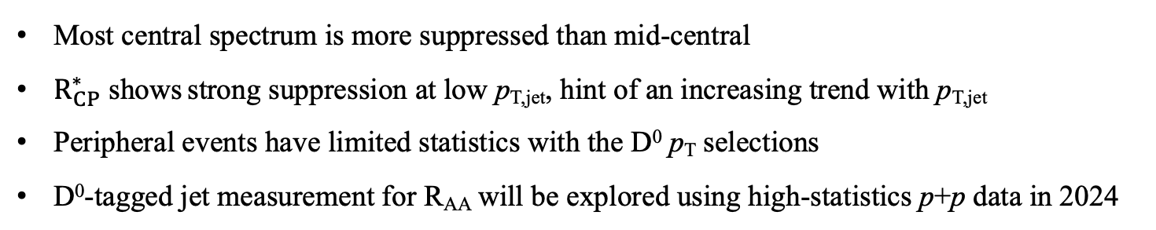
Jet Spectra
New For QM22
Most central spectrum is more suppressed than mid-central
$R_{CP}^{∗}$ shows strong suppression at low p_{T,jet}, hint of an increasing trend with p_{T,jet}
Peripheral events have limited statistics with the D⁰ p_{T} selections
D⁰-tagged jet measurement for R_{AA} will be explored using high-statistics p+p data in 2024
Notes:
EXPLAIN EVERYTHING ON THE SLIDE

Slide 19
Radial Profile of D⁰ Mesons in Jets
New For QM22
.
For D⁰ p_{T} > 5 GeV/c, the ratio of radial distributions is consistent with unity within uncertainties
Extending the analysis to lower D⁰ kinematics is essential to study D⁰ diffusion

Slide 20
Radial Profile: Data vs Model
New For QM22
CCNU, Eur. Phys. J. C79 (2019) 789
Note: calculation uses p+p as reference
Theory calculation shows small amount of diffusion - consistent with data within uncertainties
Notes:
Here we show a side-by-side of our radial profile measurement with a prediction from the CCNU model, which models both collisional and radiative energy losses for heavy quarks. The RAA for AuAu central events at 200 GeV is shown here for D0 pT > 4 GeV. The theory calculation shows a slight trend of diffusion, which is qualitatively consistent with our data due to large uncertainties. An exact comparison with this model is something we are going to pursue moving forward.

Slide 21
Summary
First D⁰-tagged jet measurement at RHIC energies
Fragmentation from PYTHIA 8 used for correcting jet momenta and substructure
Spectra for D⁰-tagged jets in central and mid-central events consistent with being suppressed with respect to peripheral events
Ratio of radial profile of D⁰ mesons in jets consistent with unity within uncertainties.
Outlook
Measure fragmentation function for D⁰-tagged jets in Au+Au collisions
Extend kinematic reach to low D⁰ p_{T} to get closer to charm quark mass

Slide 22
Backup

Slide 23
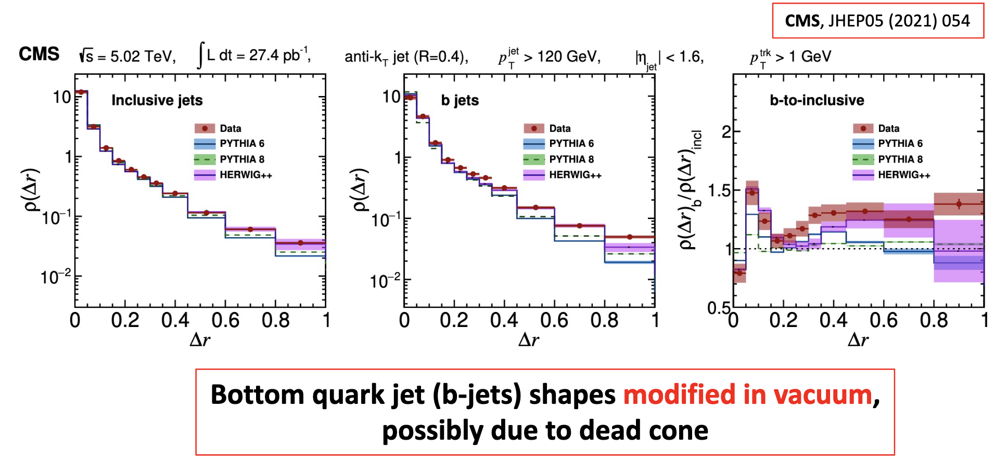
Differential jet shape for heavy quark in vacuum

Slide 24
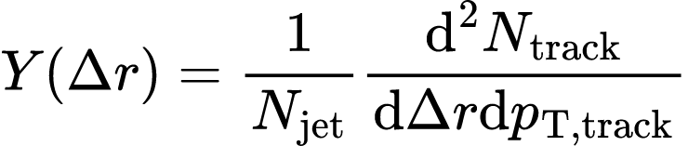
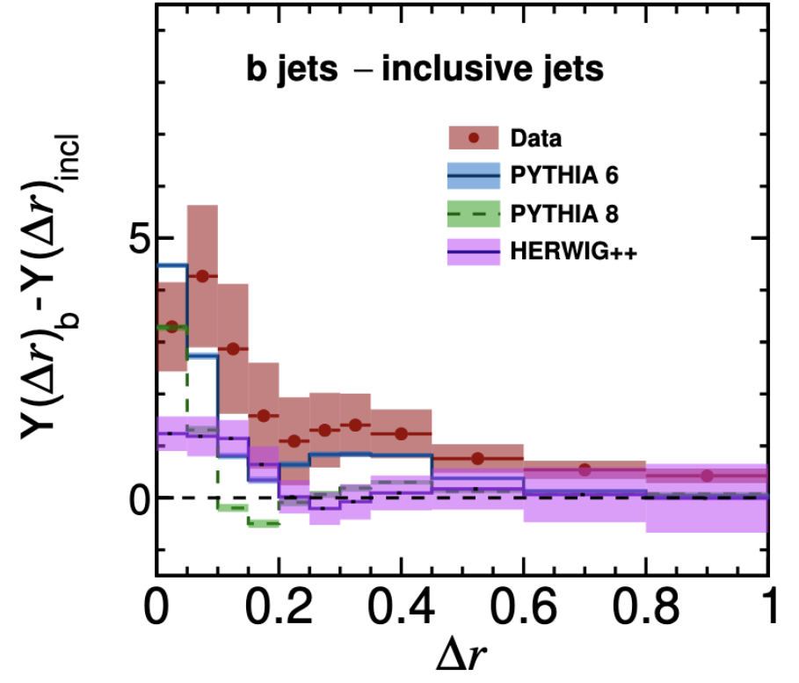
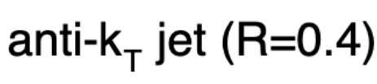
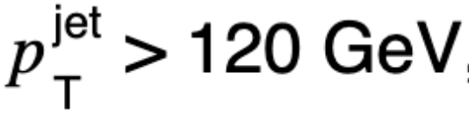

Fragmentation pattern for heavy quark
CMS, pp $\sqrt{s}=5.02$ TeV
CMS, JHEP05 (2021) 054
Higher yields of low p_{T} charged-particle close to jet axis in b-Jets vs inclusive jets in vacuum
~ Different fragmentation pattern for heavy quarks

Slide 25
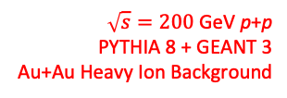
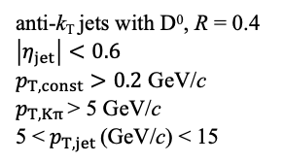
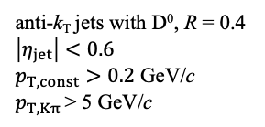
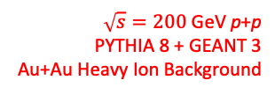
Closures For Unfolding
$\sqrt{s}=200$ GeV p+p
PYTHIA 8 + GEANT 3
Au+Au Heavy Ion Background
$\sqrt{s}=200$ GeV p+p
PYTHIA 8 + GEANT 3
Au+Au Heavy Ion Background
Simulation
Simulation
anti-k_{T} jets with D⁰, R = 0.4
$$\left|η_{jet}\right|<0.6$$
$p_{T,const}>0.2$ GeV/c
$p_{T, Kπ }$> 5 GeV/c
anti-k_{T} jets with D⁰, R = 0.4
$$\left|η_{jet}\right|<0.6$$
$p_{T,const}>0.2$ GeV/c
$p_{T, Kπ }$> 5 GeV/c
5 <${ p}_{T, jet }$(GeV/c) < 15

Slide 26
Sources of Systematics
Dominant systematic uncertainties are:
Difference in yield extraction from the two methods, and like sign subtraction
Systematics from D⁰ reconstruction (Details here: Phys. Rev. C 99 (2021) 034908)
Sub-dominant systematic uncertainties are:
FONLL as a prior vs PYTHIA 8 as a prior for the jet spectrum for unfolding
Iteration parameter in unfolding

